Slide 1
CRP Covid Recovery Program
Bill LeVeque SDSA
Weekdays..…………….517-323-6278
Evenings & Weekends..517-749-2011

Slide 2
Why now?
Effective vaccines
Improved treatments
People are smarter about sanitizing and distancing
Technology enables member engagement
Pastors need our help to bring back parishioners
The program works even with continued restrictions

Slide 3
Why do we need this?
Many councils are struggling
Many parishes are struggling
Our communities need us
Members want to help
Notes:
Total US/CAN councils = 12,107 (includes active, suspended, zero member)
Councils not recruiting = 7,424 *since July 1, 2020
Councils not reporting program activities = 10,824 *this is based on 10784 which is still not widely accepted by councils
Councils not holding any Fraternal Benefit Seminars = 10,336 *suspected reporting issue with GAs
Councils with no Grand Knight = 1,970
Councils suspended before Covid = 1,076 *none suspended since 10/10/2019

Slide 4
CRP Strategy
Keep it simple. No extra work or reports
Make it flexible and adaptable
Make it easy to succeed
Make helpful resources easy to find
Support parish recovery

Slide 5
CRP Procedures for Local Councils
Meet with Pastor and offer to help in parish recovery
Meet with District Deputy and develop a recovery plan
Engage members in council and parish recovery

Slide 6
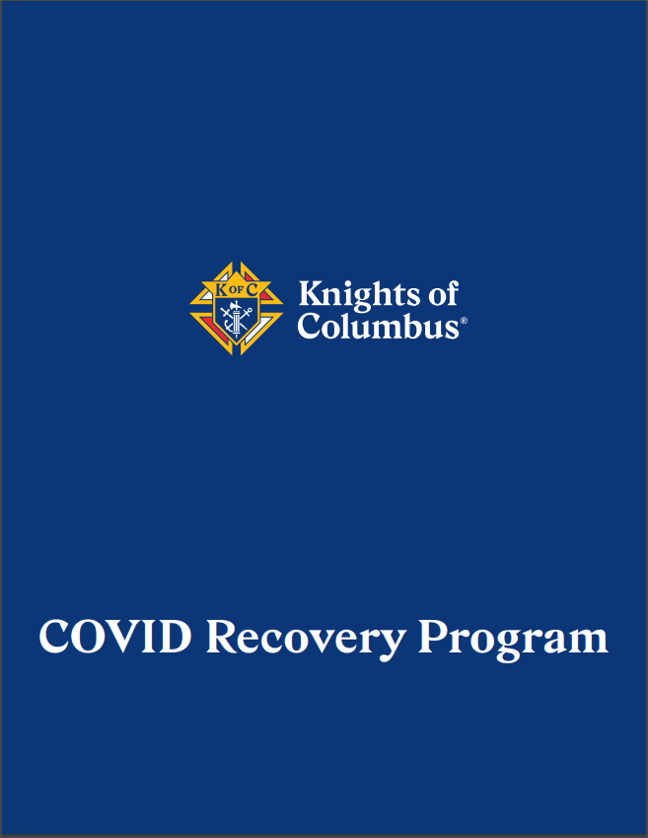
CRP Resources: The Guidebook

Slide 9
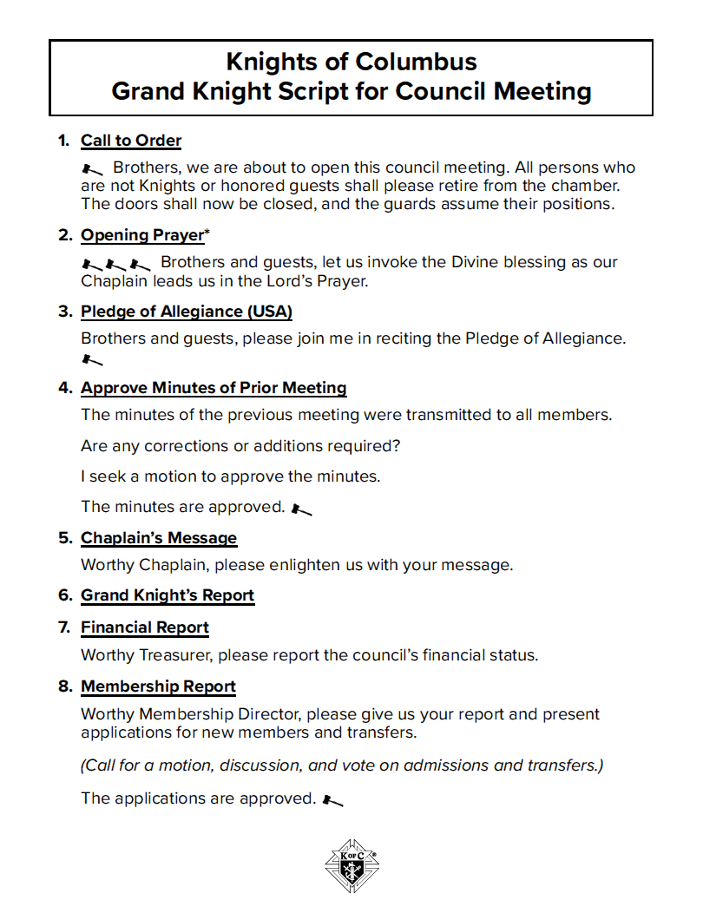

Slide 10
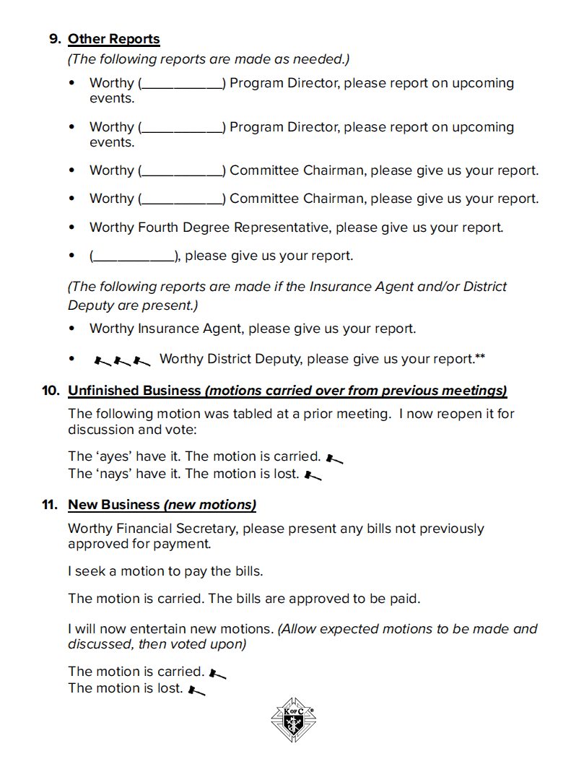

Slide 11
